Slide 1
Eutrophication Processes
Processes and Equations Implemented in WASP7 Eutrophication Module

Slide 2
DO
atmosphere
Phytoplankton
Photosynthesis
Reaeration
Periphyton
Respiration
Death&Gazing
Detritus
Oxidation
C
P
N
Dis.
Org. P
Dis.
Org. N
NH₃
PO₄
CBOD₁
Nitrification
Mineralization
Adsorption
CBOD₂
NO₃
SSinorg
CBOD₃
Denitrification
N2
Settling

Slide 3
Phytoplankton
The growth rate of a population of phytoplankton in a natural environment:
  is a complicated function of the species of phytoplankton present
  involves differing reactions to solar radiation, temperature, and the balance between nutrient availability and phytoplankton requirements
Due to the lack of information to specify the growth kinetics for individual algal species in a natural environment,
  this model characterizes the population as a whole by the total biomass of the phytoplankton present

Slide 4
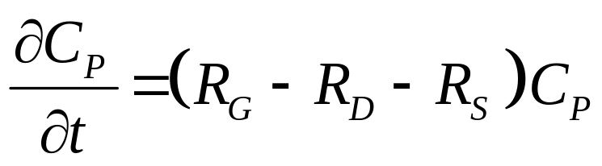
Phytoplankton Kinetics
Si
NO3
Light
NH3
Phyt
O C:N:P
PO₄
Where:
C_{p} | = phytoplankton carbon concentration (mg/L)
R_{G} | = growth rate constant (per day)
R_{D} | = death rate constant (per day)
R_{S} | = settling rate constant (per day)

Slide 5
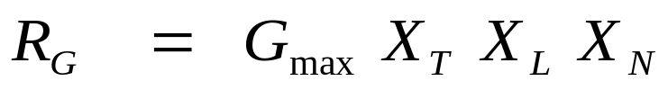
Phytoplankton Growth
NO3
Light
NH3
Phyt
O C:N:P
Growth rate constant:
PO₄
G_{max} = maximum specific growth rate constant at 20 C, 0.5 – 4.0 day⁻¹
X_{T} = temperature growth multiplier , dimensionless
X_{L} = light growth multiplier, dimensionless
X_{N} = nutrient growth multiplier, dimensionless

Slide 6
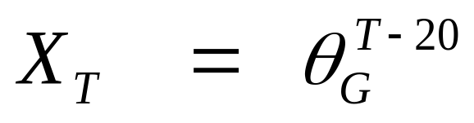
Temperature Effects on Phytoplankton
Temperature multiplier:
where
_{G} = temperature correction factor for growth (1.0 – 1.1)
T = water temperature, C

Slide 7
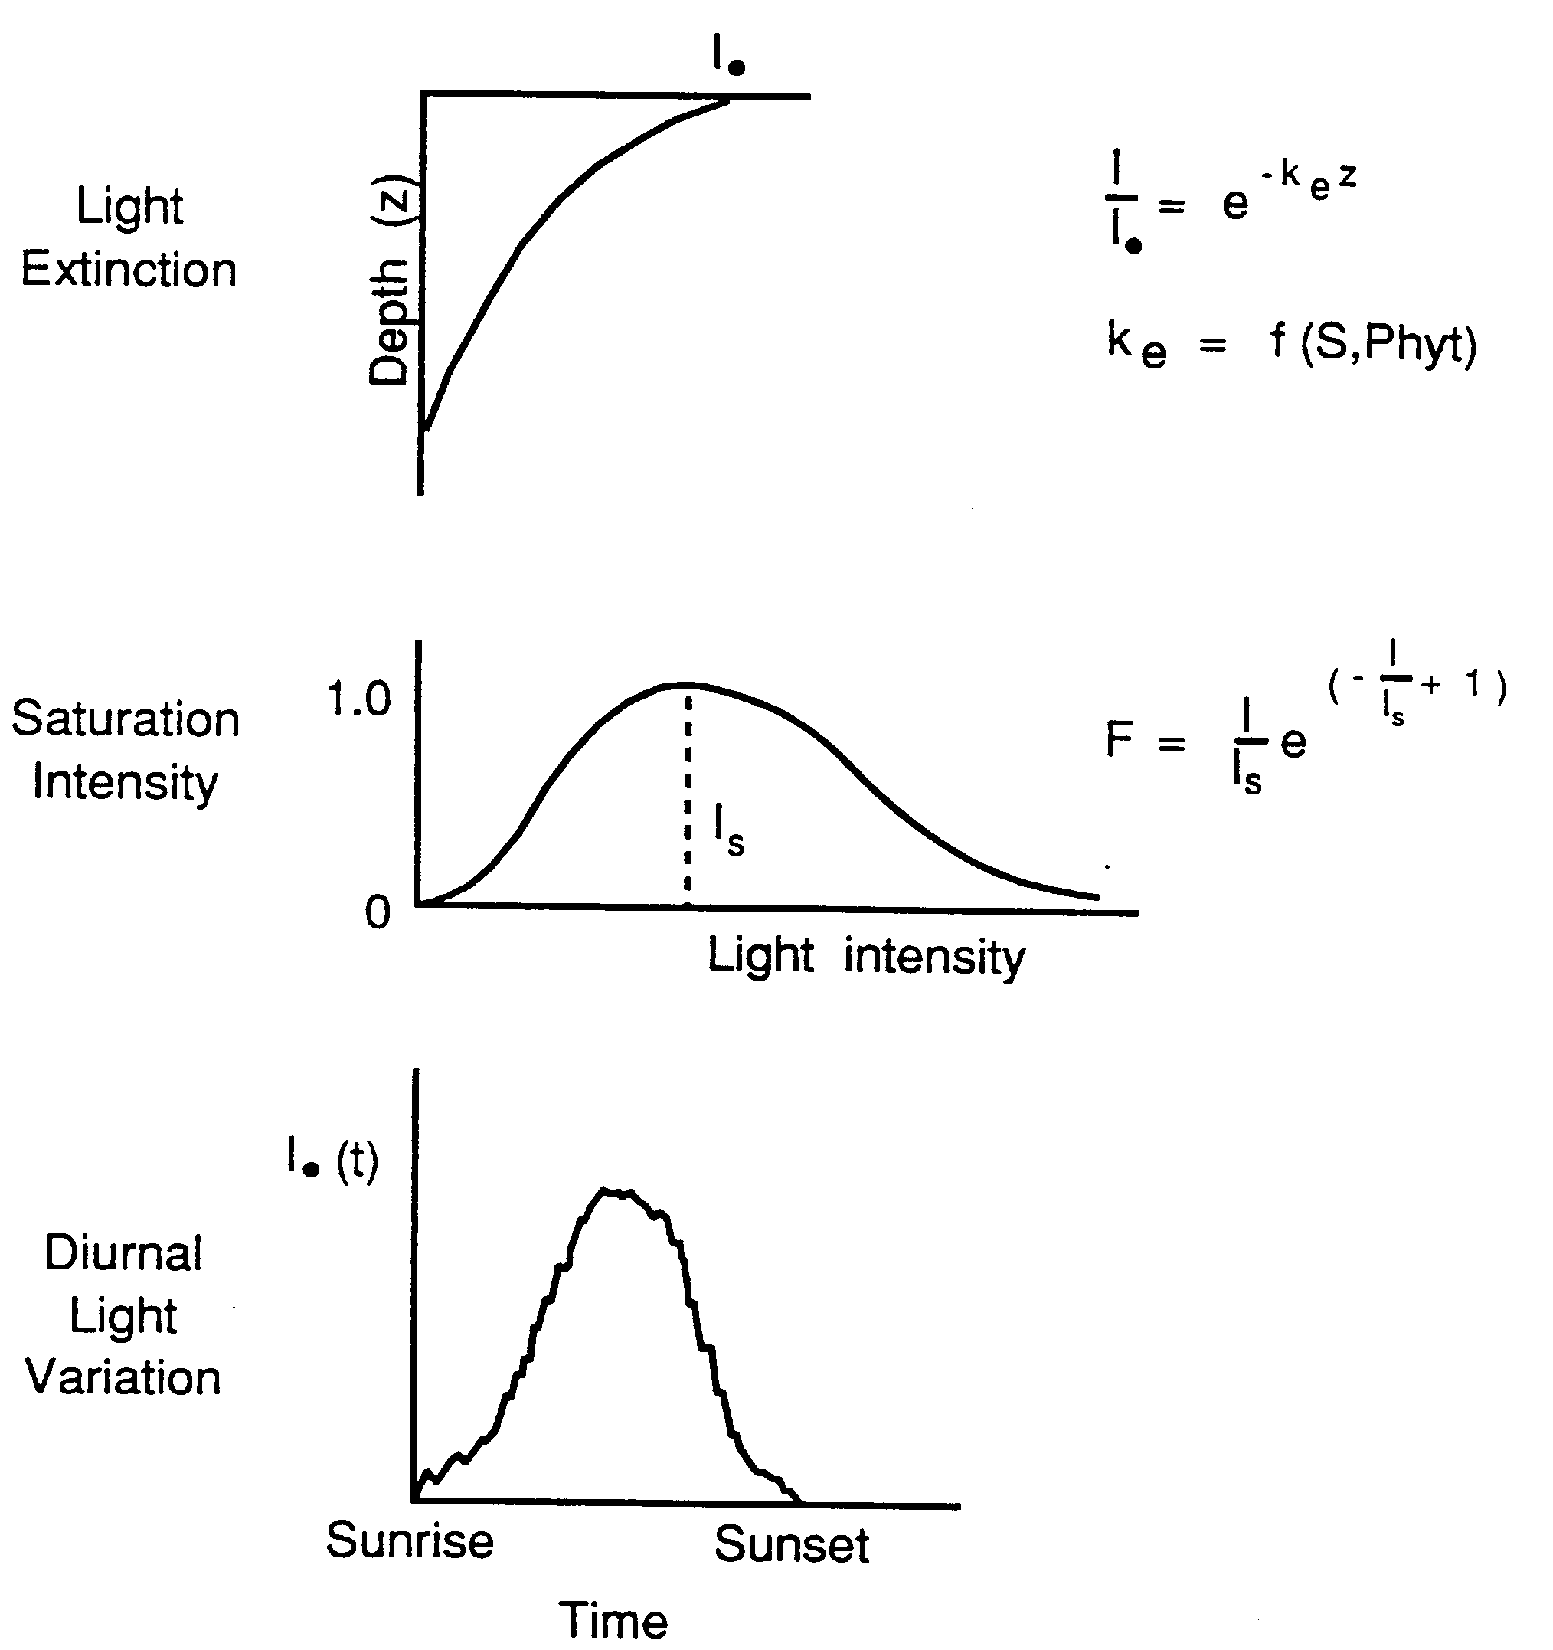
Light Effects on Phytoplankton

Slide 8
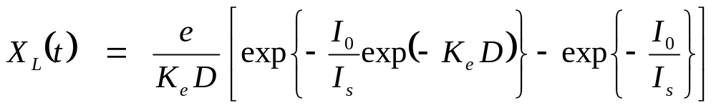
Light Effects on Phytoplankton
Integrated over depth:
D = average depth of segment, m
K_{e} = total light extinction coefficient , per meter
I₀ = incident light intensity just below the surface, langleys/day (assumes 10% reflectance)
I_{s} = saturating light intensity of phytoplankton, langleys/day

Slide 9
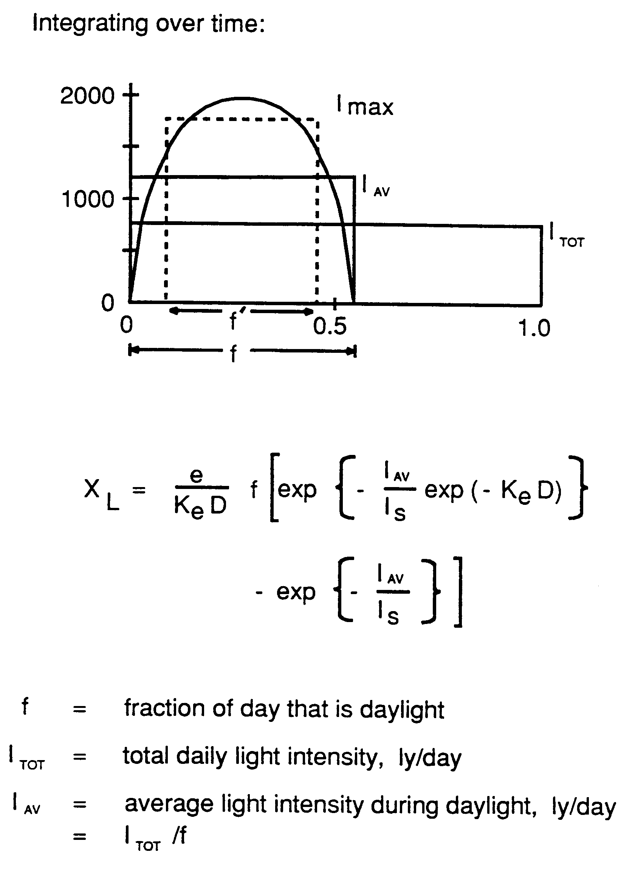
Light Effects on Phytoplankton

Slide 10
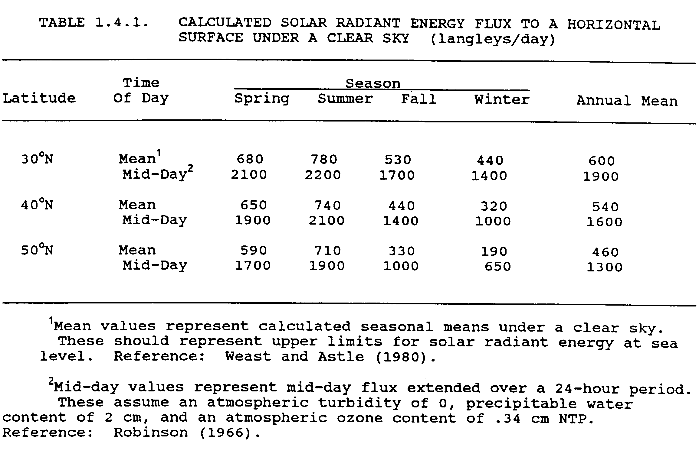
Light

Slide 11
Total Light Extinction
K_{e back} = background light extinction due to ligands, color, etc.
K_{e shd} = algal self shading,
K_{e solid} = solids light extinction
K_{e DOC} = DOC light extinction,

Slide 12
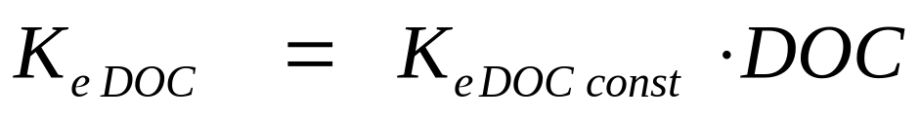
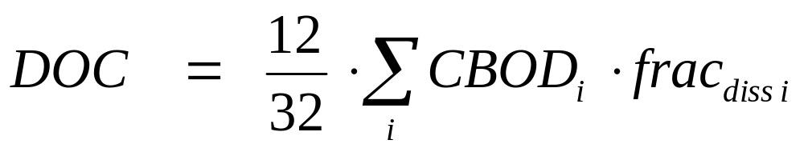
Light Extinction Components
Background:
Solids:
DOC:

Slide 13
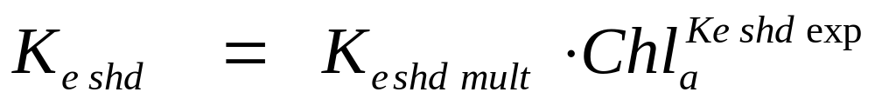
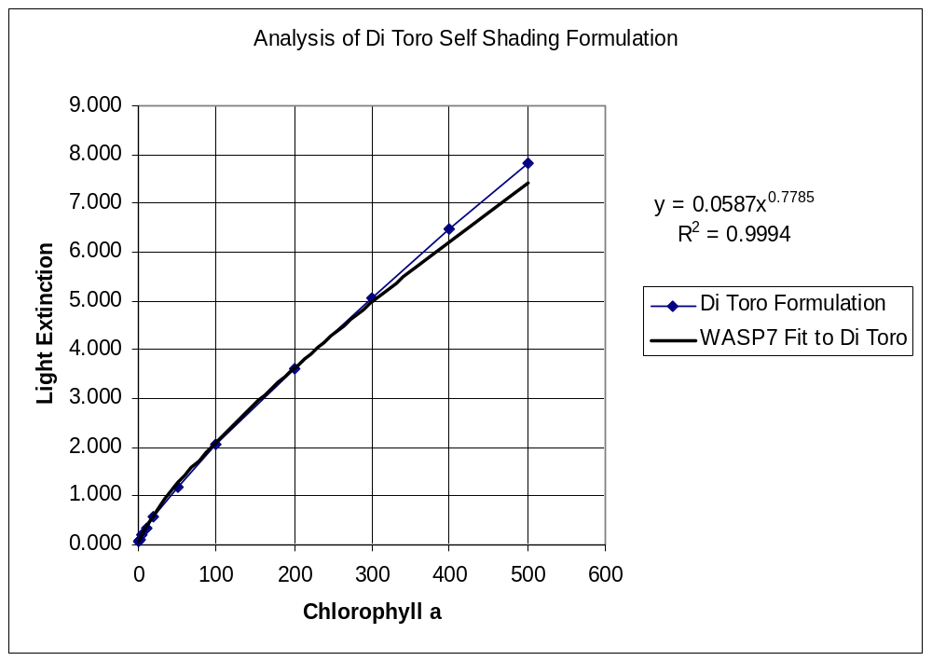
Light Extinction Formulation
Algal Self Shading:
Options:
Model Calculates (Default)
  Mult = 0.0587, Exp= 0.778
User Specifies Mult & Exp
Switch Off Self Shading

Slide 14
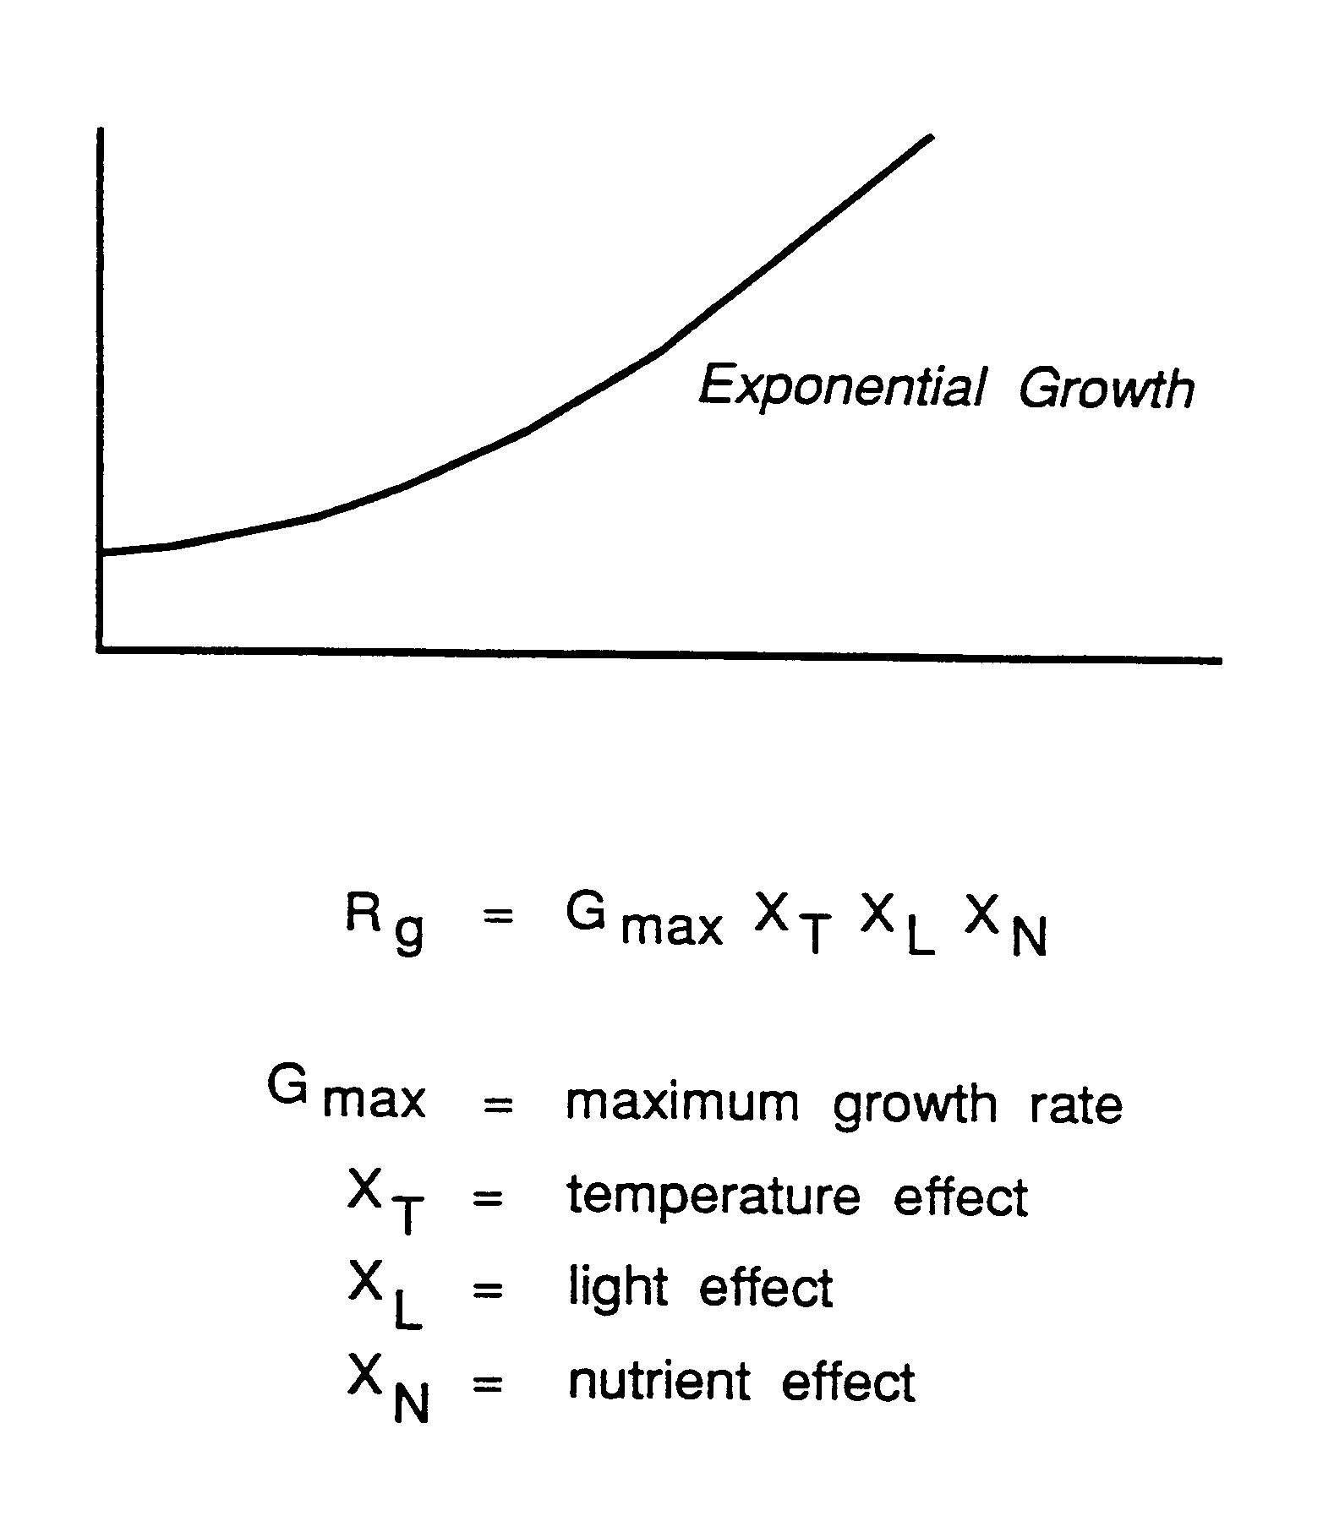
Phytoplankton Growth, reprise

Slide 15
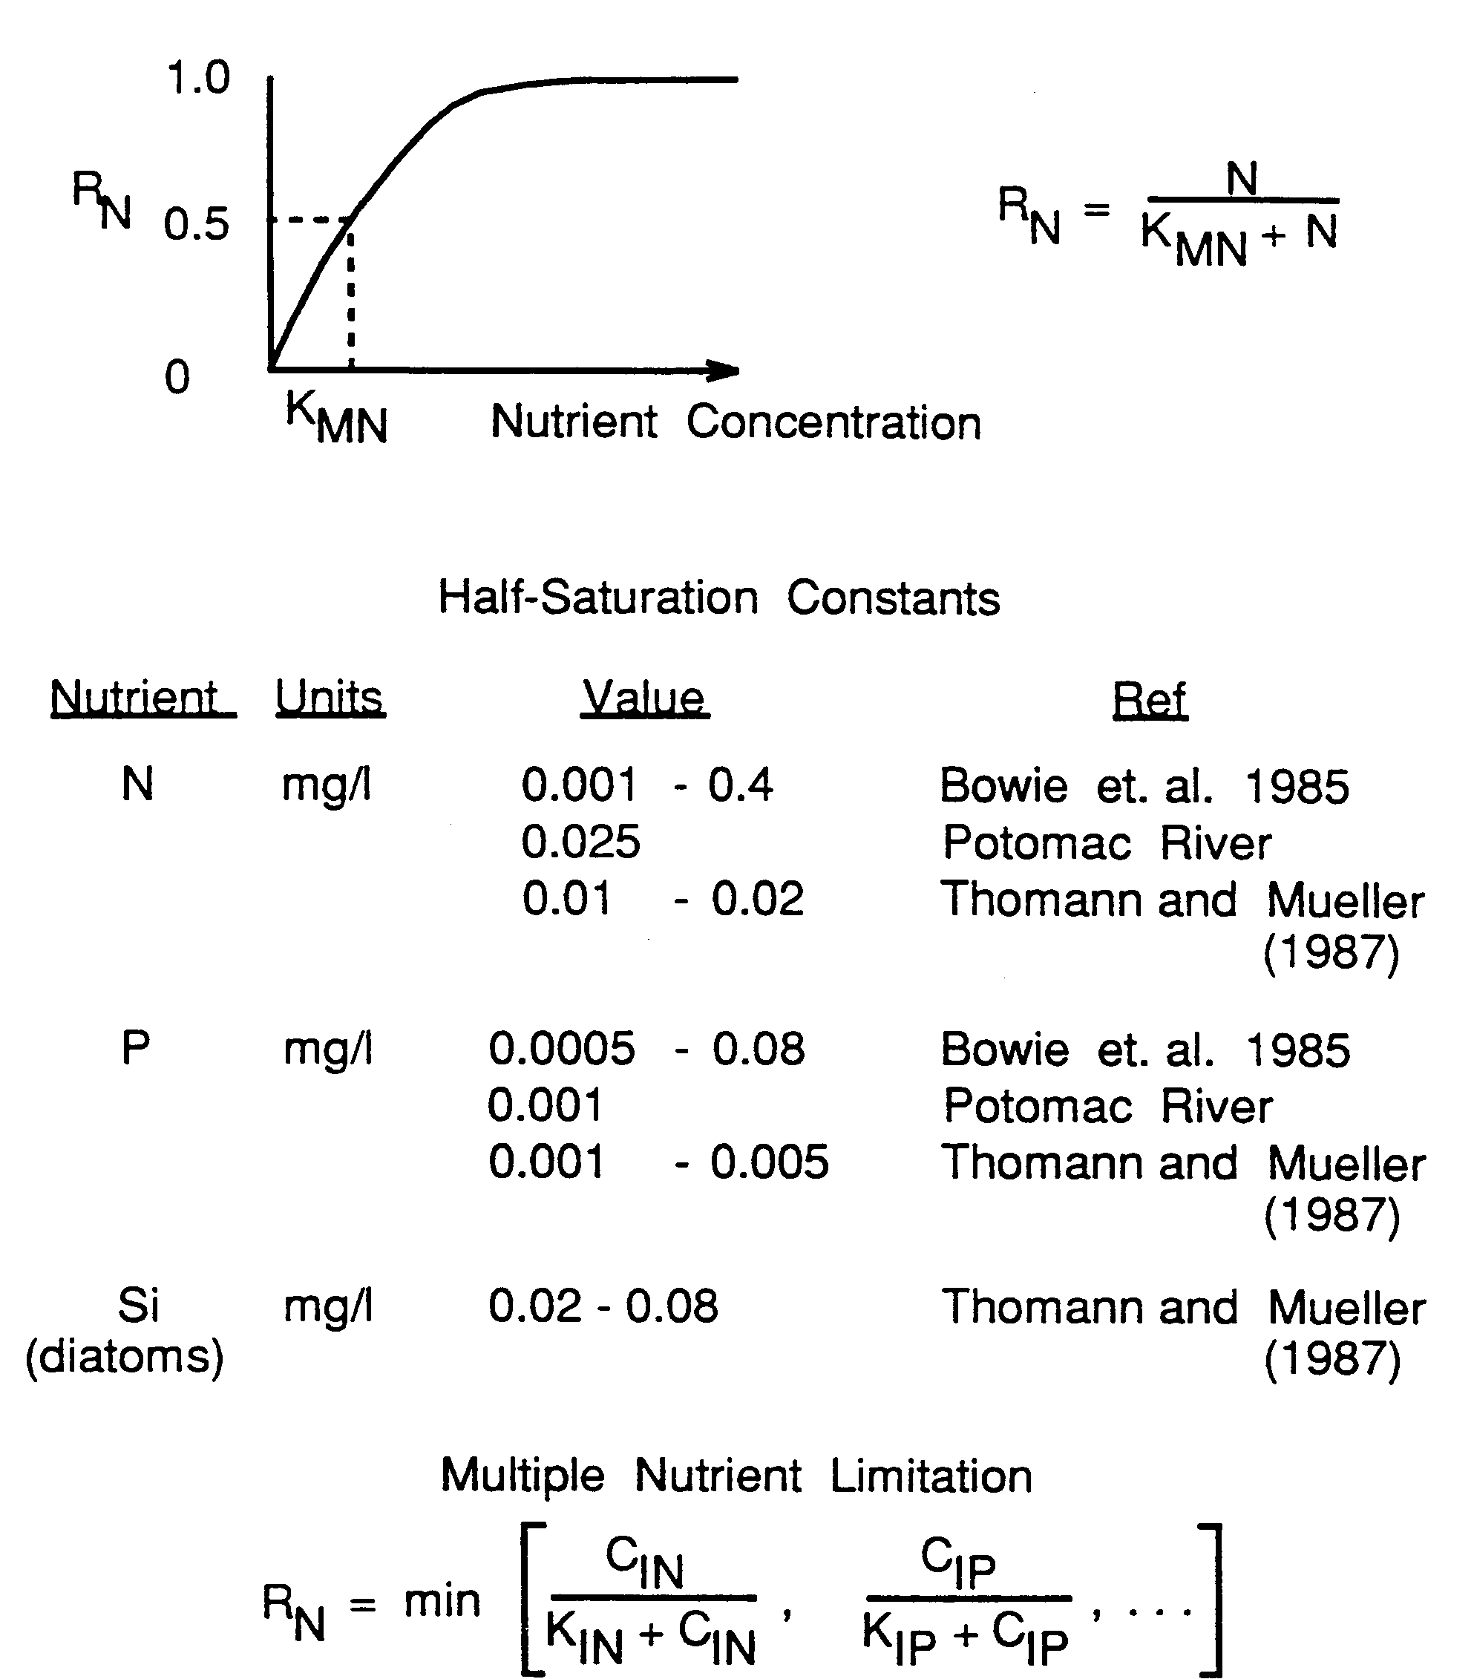
Nutrient Effect on Phytoplankton

Slide 16
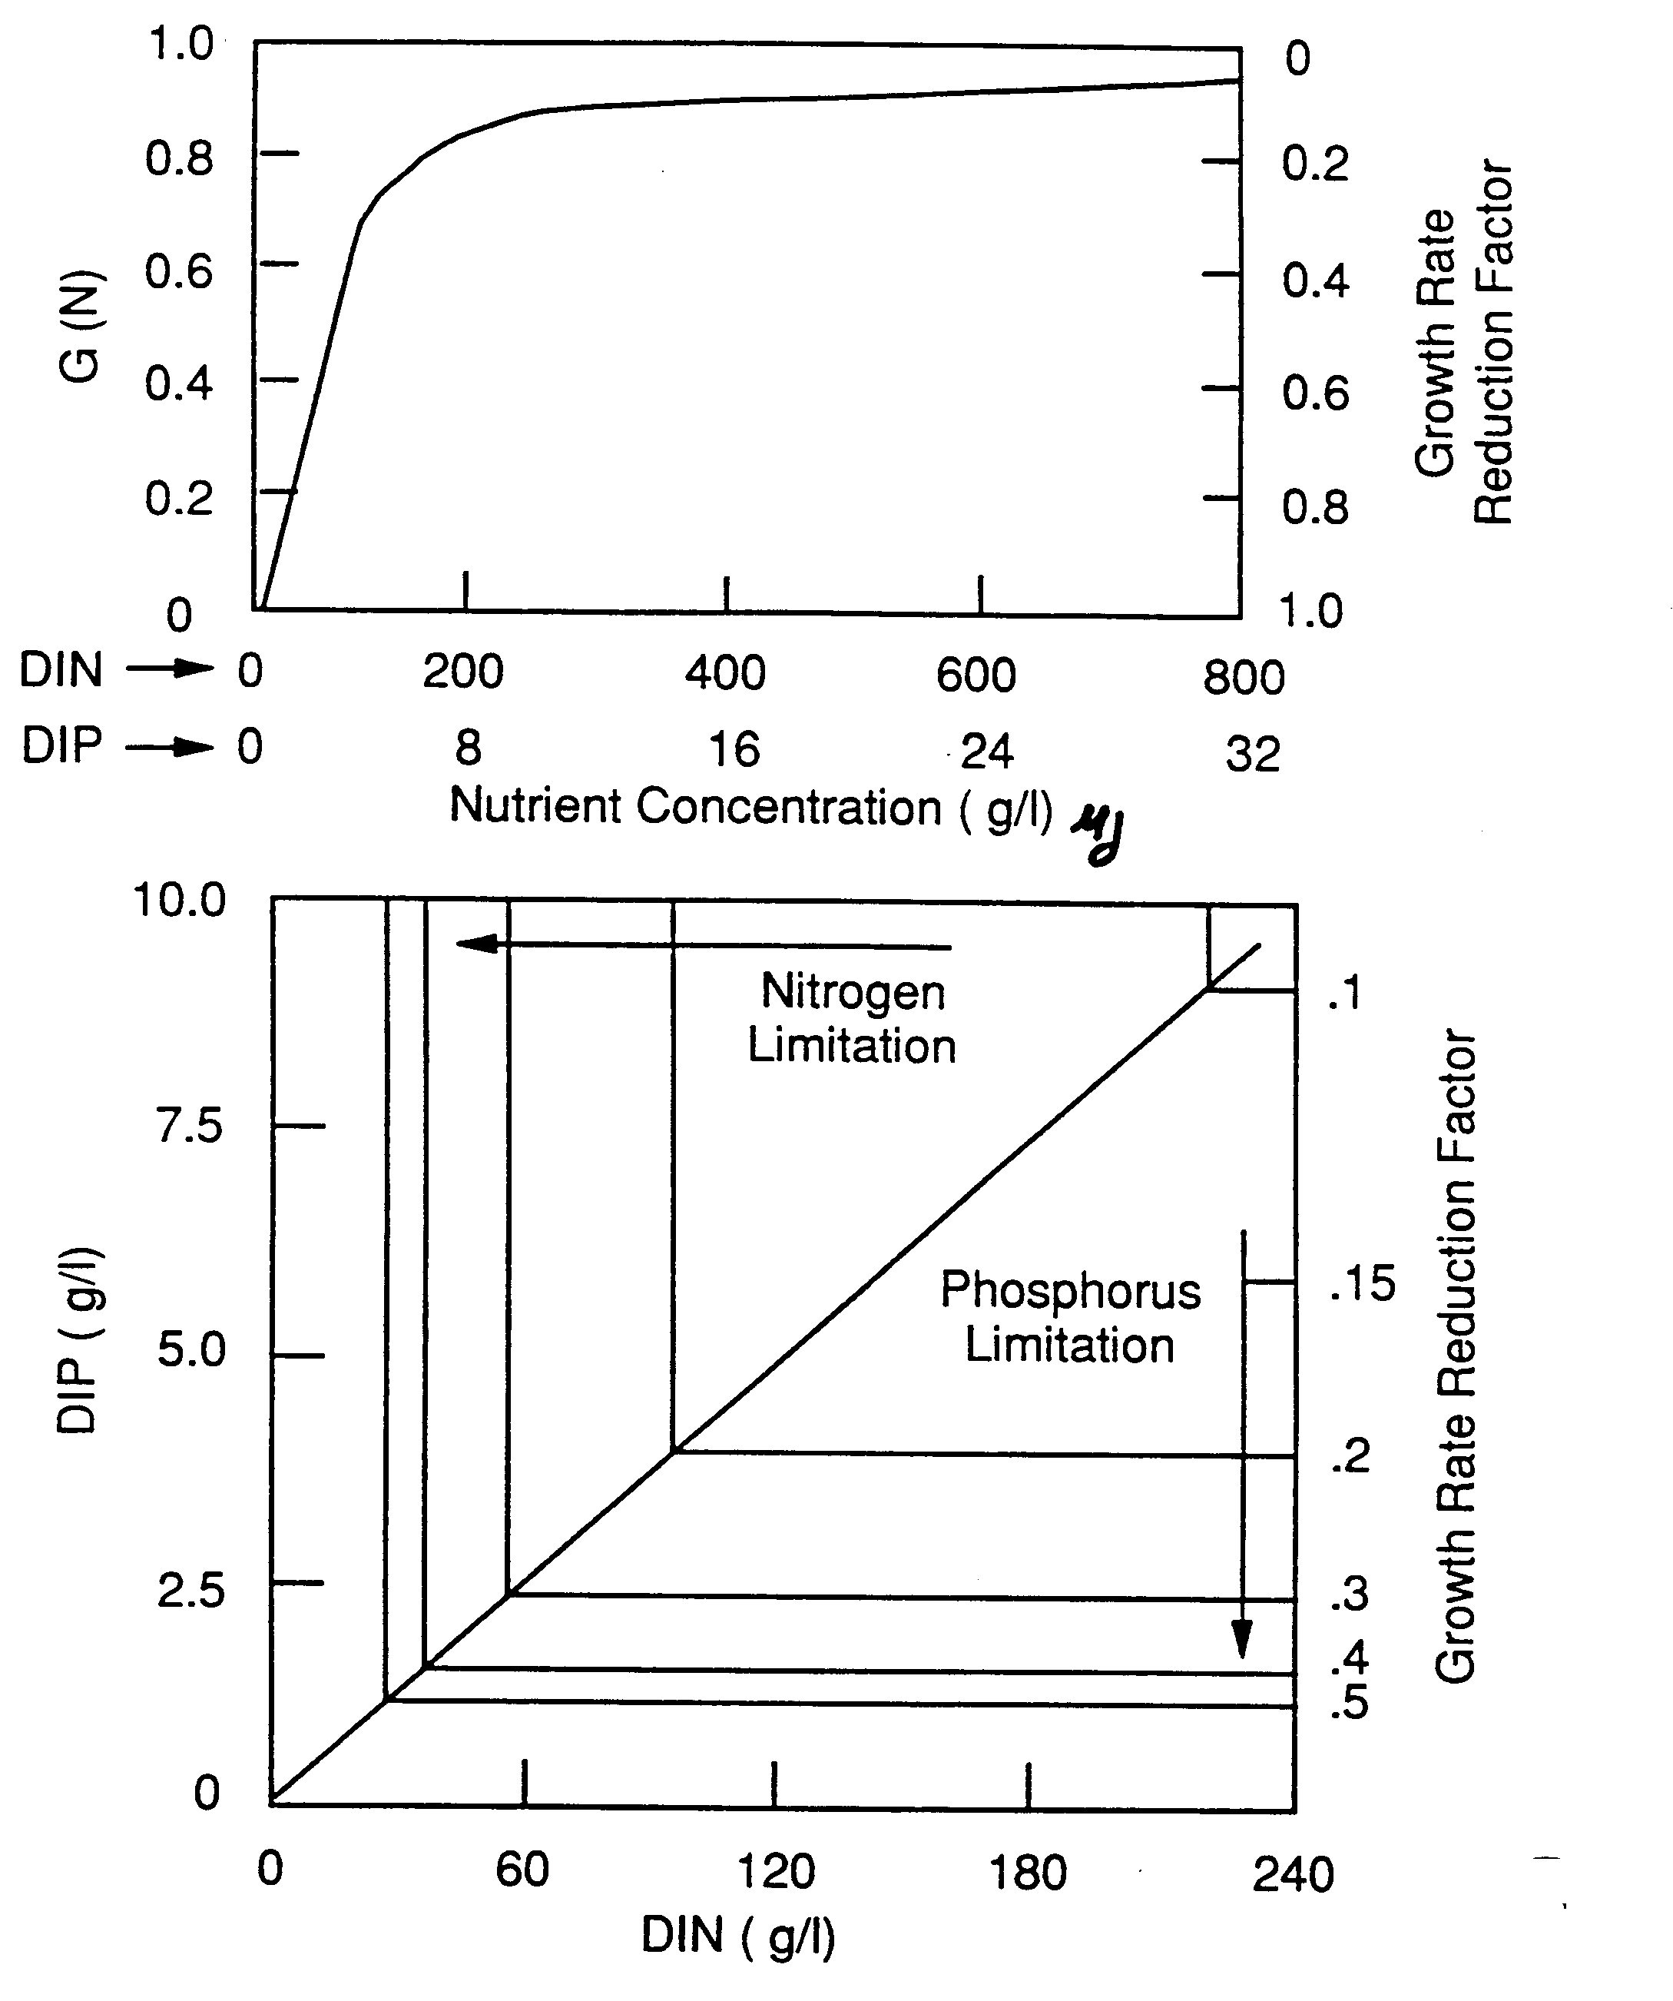
Nutrient Limitation on Growth

Slide 17

Phytoplankton “Death”
NO3
Light
NH3
Phyt
O C:N:P
Death rate constant:
PO₄
k_{1R} = endogenous respiration rate constant, day⁻¹
_{1R} = temperature correction factor, dimensionless
k_{1D} = mortality rate constant, day⁻¹
k_{1G} = grazing rate constant, day⁻¹, or m³/gZ-day if Z(t) specified
Z(t) = zooplankton biomass time function, gZ/m³ (defaults to 1.0)

Slide 18

Phytoplankton Settling
NO3
Light
NH3
Phyt
O C:N:P
Settling rate constant:
PO₄
v_{S} = settling velocity, m/day
A_{S} = surface area, m²
V = segment volume, m³

Slide 19
Benthic Algae
or periphyton

Slide 20
Differences Fixed and Floating Plants
 | Floating | Attached
Transport | Yes | No
Types | Diatoms Greens Blue Greens | Periphyton Filamentous Algae Rooted Macrophytes
Units | mg chl-a/m³ | gD/m² or mg A/m²
Light | Average Water Column | Light at Bottom
Predation | Zooplankton | Insect Larvae, Snails
Substrate | Not an Issue | Rock vs. Mud

Slide 21
Functional Groups
Periphyton: algae attached to and living upon submerged solid surfaces
Filamentous Algae
  Cladophora
Macrophytes: Vascular, Rooted Plants
  Myriophyllum, Elodea, Potamogeton

Slide 22
Lakes versus Rivers
load
transport
load

Slide 23
“Shallow Stream with Attached Plants”
c
100
Fixed
Plants
N, P
Organic or
“Lost”
Fraction
f
(gC/m
2
)
50
0
c
, c
2
n
p
(gN/m
3
, gP/m
3
)
1
0
c
o
20
(gC/m
3
)
10
0
0
2000
4000
Downstream Distance, m
x

Slide 24
Typical Rates
Maximum growth rate ≅ 30 g/m²/d (10-100)
Respiration rate ≅ 0.1/d (0.05-0.2)
Death rate ≅ 0.05/d (0.01-0.5) (During sloughing could be higher)
Nutrient half-saturation constants tend to be higher that phytoplankton by a factor of 10 to 100

Slide 25
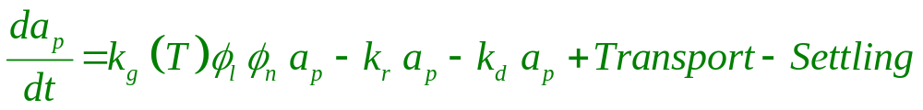
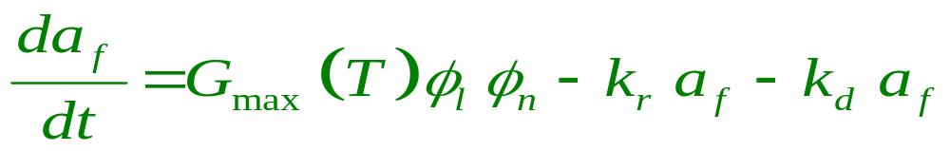
Periphyton Model
Phytoplankton:
Based on Average Light
Periphyton:
Based on Bottom Light

Slide 26
Effect of Light on Periphyton
(
a
) floating plants
(
b
) periphyton

Slide 27
Overview of Nutrient Cycling
Phytoplankton, C
Periphyton, C-dw
1
adc
PCRB
apc/adc
NCRB
anc/adc
1-fon
1-fop
fop
fon
Detr
C
Detr
P
Detr
N
kdiss
OCRB
kdiss
1
kdiss
1
Inorganic pool
CBODi
Diss.
Org. P
Diss.
Org. N

Slide 28
The Phosphorus Cycle
Inorganic P
  DIP taken up by algae (phytoplankton and periphyton) for growth
  DIP sorbs to solids to form particulate inorganic P
  Particulate inorganic P may settle with inorganic solids
Organic P
  during algal respiration and death, a fraction of the cellular phosphorus is recycled to the inorganic pool
  the remaining fraction is recycled to the detrital P pool
  particulate detrital P may settle out at the same velocity as organic matter (v_{s3})
  Particulate detrital P dissolves to DOP
  DOP mineralizes to DIP

Slide 29
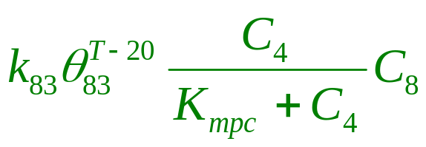
Phosphorus Cycle
Phytoplankton
4
_{DpC4apc}
Detr. P
15
_{DpC4apc(1-fop)}
_{KdissC15}
_{GpC4apc}
PO₄
3
Org. P
8
_{C3(1-fd3)}
_{C8(1-fd8)}

Slide 30
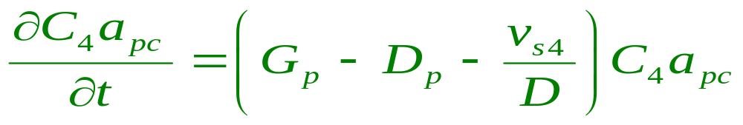
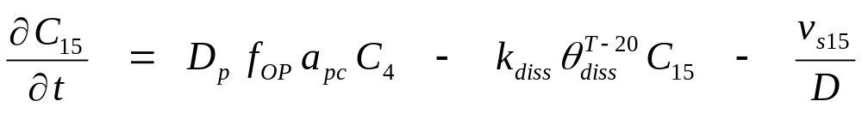
Phosphorus Equations
Phytoplankton P
Detrital P
Growth
Death
Settling
Death
Dissolution
Settling

Slide 31
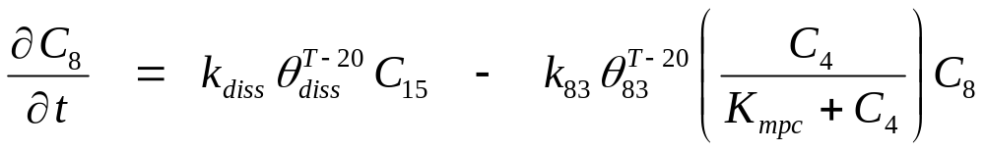
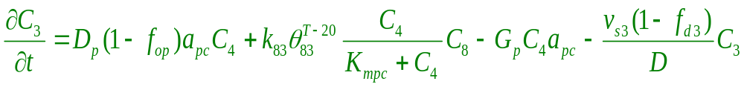
Phosphorus Equations
Dissolved Organic P
Inorganic P
Dissolution
Mineralization
Death
Mineralization
Growth
Settling

Slide 32
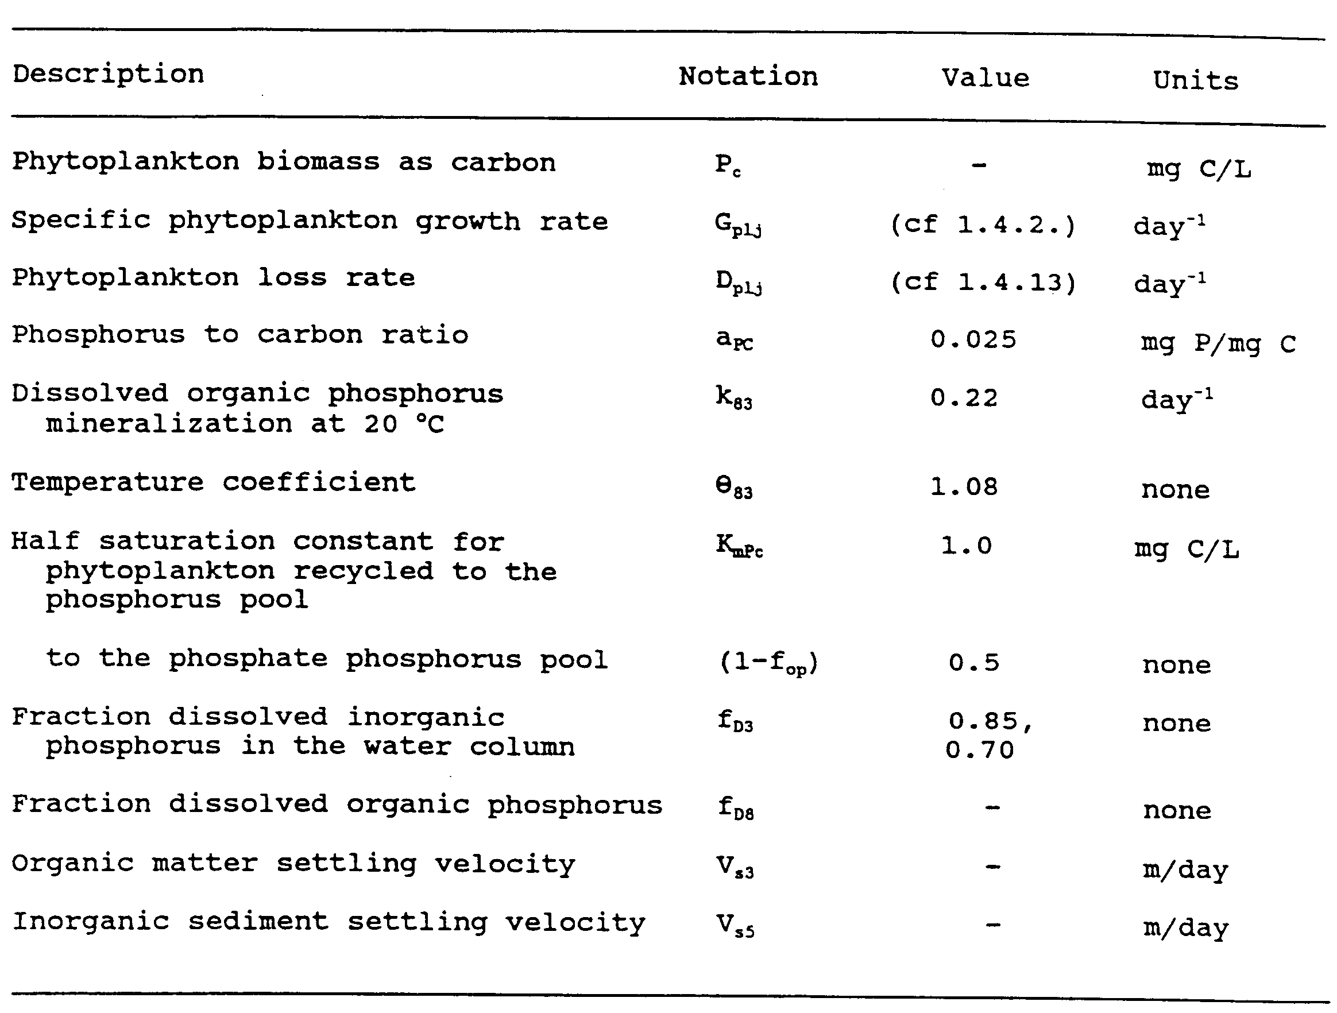
Phosphorus Reaction Terms

Slide 33
Nitrogen Cycle
Inorganic N pool:
  ammonia and nitrate N are used by algae (phytoplankton and periphyton) for growth
  for physiological reasons ammonia is preferred
  the rate at which each form is taken up is proportional to its concentration relative to the total inorganic N (NH₃+NO₃) available
  Ammonia is nitrified to nitrate at a temperature and oxygen dependent rate
  Nitrate is denitrified to N₂ gas at low DO levels at a temperature dependent rate

Slide 34
Nitrogen Cycle
Organic N pool:
  during algal respiration and death, a fraction of the cellular nitrogen is recycled to the inorganic pool in the form of ammonia nitrogen
  the remaining fraction is recycled to the detrital N pool
  particulate detrital N may settle out at the same velocity as organic matter (v_{s3})
  particulate detrital N dissolves to DON
  DON mineralizes to ammonia-N

Slide 35
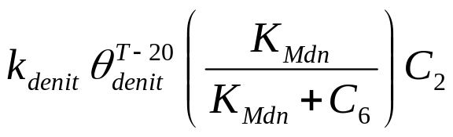
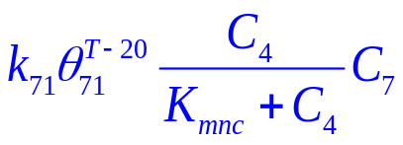
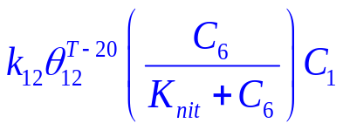
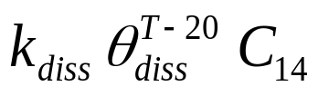
Nitrogen Cycle
N₂
NO₃
2
Org. N
7
G_{p}C₄a_{nc}
×(1-P_{NH3})
NH₃
1
G_{p}C₄a_{nc}
Phytoplankton
4
D_{p}C₄a_{nc}
Detr. N
14
×P_{NH3}
×f_{on}
×(1-f_{on})

Slide 36
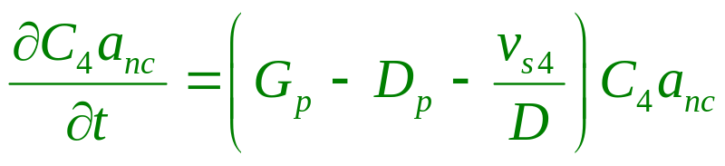
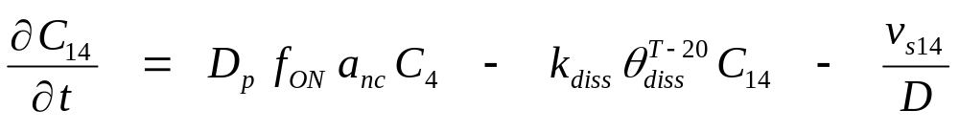

Summary of Nitrogen Equation organic components
Phyt N
Detrital N
DON

Slide 37
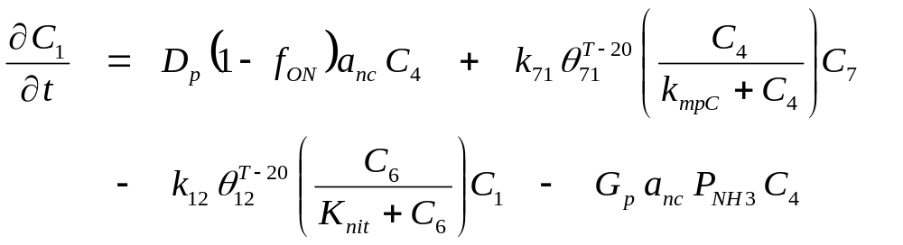
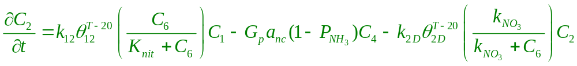
Summary of Nitrogen Equations inorganic components
NH₃ N
NO₃ N

Slide 38
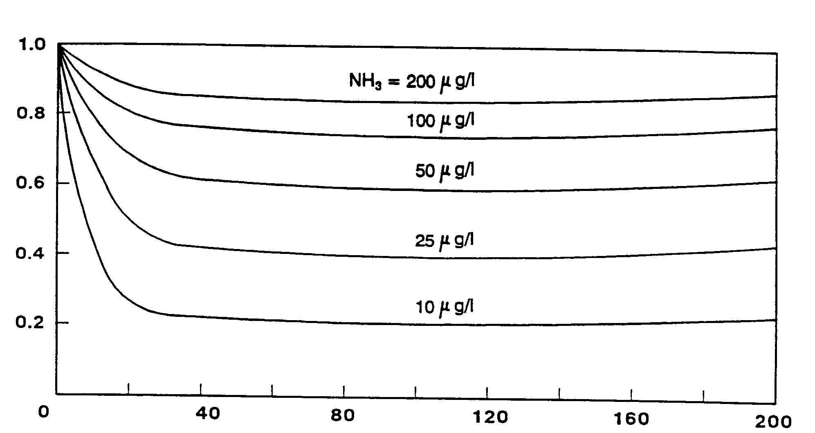
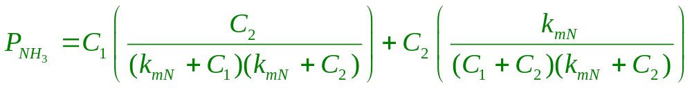
Ammonia Preference Factor
P_{NH3}
k_{mN} = 25 μg/L
NO₃ , μg/L

Slide 39
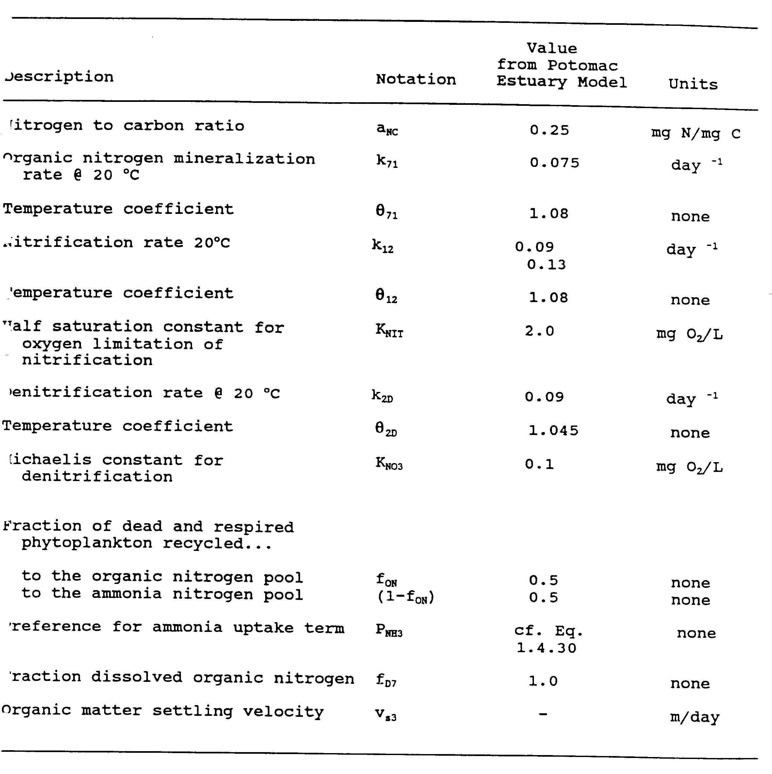
Nitrogen Reaction Terms

Slide 40
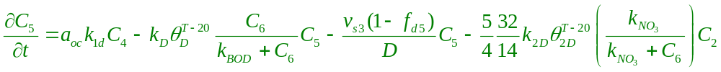
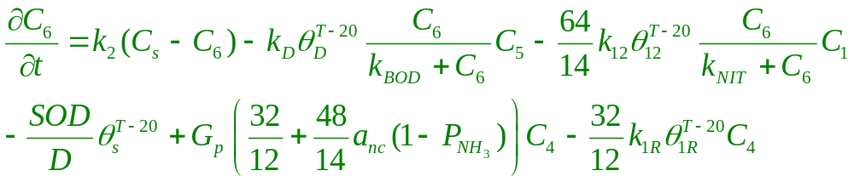
DO-BOD-Phytoplankton Equations
CBOD
DO

Slide 41
DO Production from Phytoplankton Growth using NO₃
Two steps in synthesis of biomass (CN_{x}OP) from NO₃
(1) x NO₃ → x NH₄ + (³/₂) x O₂
(2) CO₂ + x NH₄ → CN_{x}OP + O₂
(net) CO₂ + x NO₃ → CN_{x}OP + ( ³/₂ x + 1 ) O₂
Synthesizing 1 mole of C produces ( ³/₂ x + 1 ) moles of O₂
Synthesizing 1 gram of C produces (³²/₁₂) [ ³/₂ x + 1 ] grams of O₂
Given a_{NC} (g N / g C) in phytoplankton, x = (¹²/₁₄) a_{NC} moles
Synthesizing 1 gram of C, then, produces:
(³²/₁₂) [ (³/₂) (¹²/₁₄) a_{NC} + 1] grams of O₂
= 32 [ (^{1.5}/₁₄) a_{NC} + (¹/₁₂) ] grams of O₂ (in Wasp6 code)
= [ (⁴⁸/₁₄) a_{NC} + (³²/₁₂) ] grams of O₂ (in Wasp6 manual)

Slide 42
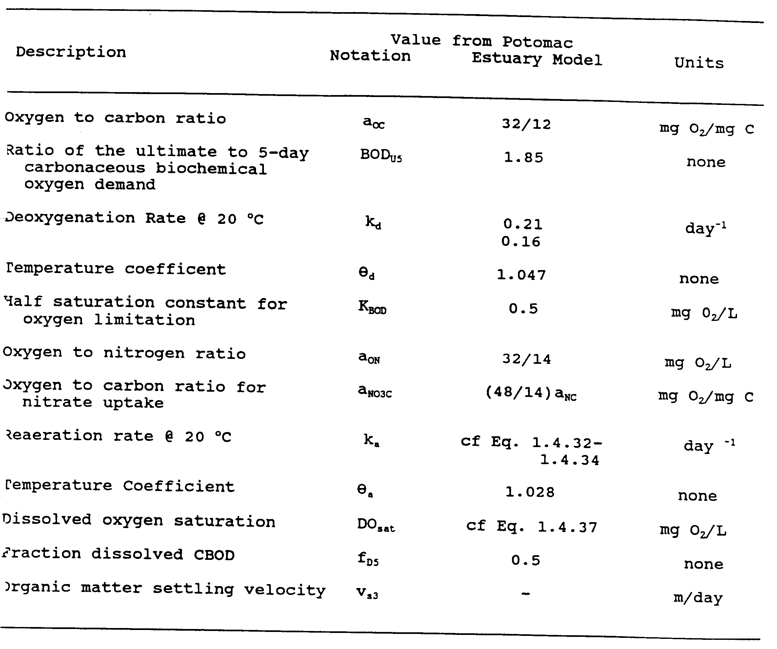
DO/BOD Reaction Terms

